Slide 1
How to ...
Python code to crop/mirror videos and adjust frames per second
Markus Aswendt, PhD
University Hospital Cologne - Department of Neurology
Cologne, Germany
03/10/2023

Slide 2
Introduction
The Problem
Rotating Beam Videos need to be adjusted before being processed with Deeplabcut:
Crop (to limit size and show beam only, limit background)
FPS (FPS might be variable because of camera/PC issues, needs to be adjusted so that calculation per frames are correct later on)
Mirror (some videos were acquired up-side-down)

Slide 3
Introduction
av 10.0.0 pypi_0 pypi
bzip2 1.0.8 h0d85af4_4 conda-forge
ca-certificates 2022.4.26 hecd8cb5_0 anaconda
contourpy 1.0.7 pypi_0 pypi
cycler 0.11.0 pypi_0 pypi
ffmpeg 1.4 pypi_0 pypi
ffmpeg-python 0.2.0 pypi_0 pypi
fonttools 4.39.0 pypi_0 pypi
freetype 2.12.1 h3f81eb7_1 conda-forge
future 0.18.3 pypi_0 pypi
kiwisolver 1.4.4 pypi_0 pypi
lcms2 2.15 h2dcdeff_1 conda-forge
lerc 4.0.0 hb486fe8_0 conda-forge
libcxx 15.0.7 h71dddab_0 conda-forge
libdeflate 1.17 hac1461d_0 conda-forge
libffi 3.4.2 h0d85af4_5 conda-forge
libjpeg-turbo 2.1.5.1 hb7f2c08_0 conda-forge
libpng 1.6.39 ha978bb4_0 conda-forge
libsqlite 3.40.0 ha978bb4_0 conda-forge
libtiff 4.5.0 hd920806_5 conda-forge
libwebp-base 1.2.4 h775f41a_0 conda-forge
libxcb 1.13 h0d85af4_1004 conda-forge
libzlib 1.2.13 hfd90126_4 conda-forge
matplotlib 3.7.1 pypi_0 pypi
ncurses 6.3 h96cf925_1 conda-forge
numpy 1.24.2 pypi_0 pypi
opencv-python 4.7.0.72 pypi_0 pypi
openjpeg 2.5.0 h13ac156_2 conda-forge
openssl 3.0.8 hfd90126_0 conda-forge
packaging 23.0 pypi_0 pypi
pillow 9.4.0 py311hf47c0a6_2 conda-forge
pip 23.0.1 pyhd8ed1ab_0 conda-forge
pthread-stubs 0.3 hdd91f34_1 anaconda
pyparsing 3.0.9 pypi_0 pypi
python 3.11.0 he7542f4_1_cpython conda-forge
python-dateutil 2.8.2 pypi_0 pypi
python_abi 3.11 3_cp311 conda-forge
readline 8.1.2 h3899abd_0 conda-forge
regex 2022.10.31 pypi_0 pypi
setuptools 67.5.1 pyhd8ed1ab_0 conda-forge
six 1.16.0 pypi_0 pypi
subprocess32 3.5.4 pypi_0 pypi
tk 0.1.0 pypi_0 pypi
tzdata 2022g h191b570_0 conda-forge
wheel 0.38.4 pyhd8ed1ab_0 conda-forge
xorg-libxau 1.0.9 h35c211d_0 conda-forge
xorg-libxdmcp 1.1.3 h35c211d_0 conda-forge
xz 5.2.6 h775f41a_0 conda-forge
zstd 1.5.2 hbc0c0cd_6 conda-forge
Preparation
Create conda environment:
Python==3.11.0
Packages:

Slide 4
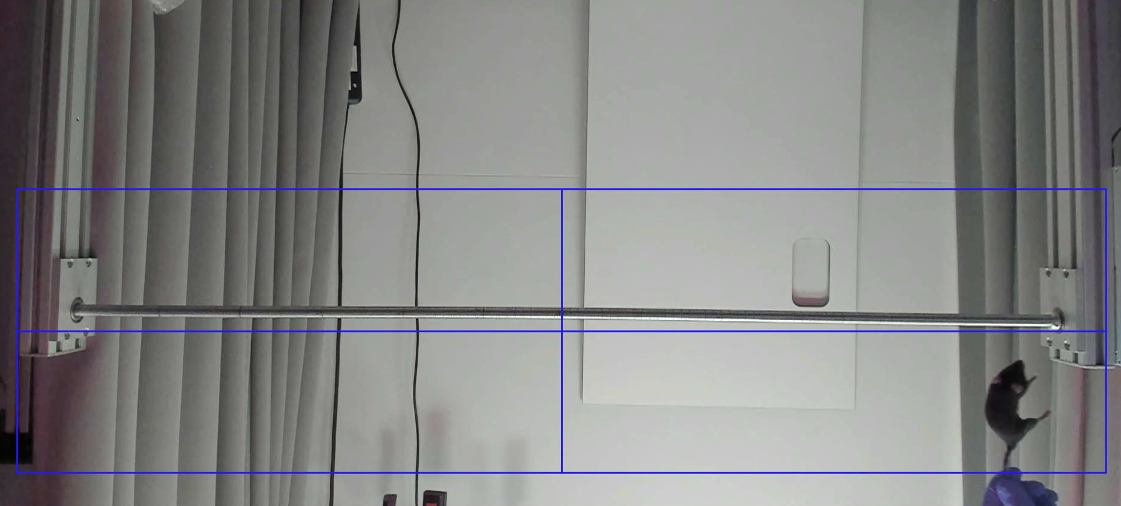
Solution 1
The Solution: for single videos
import os import tkinter as tk from tkinter import filedialog import cv2 def get_videos(): root = tk.Tk() root.withdraw() file_paths = filedialog.askopenfilenames(title='Choose video file(s)', filetypes=[('Video Files', '*.mp4')]) return file_paths def get_crop_box(video_path): cap = cv2.VideoCapture(video_path) _, frame = cap.read() cap.release() return cv2.selectROI(frame) def crop_video(video_path, crop_box): cap = cv2.VideoCapture(video_path) fps = cap.get(cv2.CAP_PROP_FPS) width = int(cap.get(cv2.CAP_PROP_FRAME_WIDTH)) height = int(cap.get(cv2.CAP_PROP_FRAME_HEIGHT)) fourcc = cv2.VideoWriter_fourcc(*'mp4v') video_name, ext = os.path.splitext(video_path) video_name += '_cropped' save_path = video_name + ext out = cv2.VideoWriter(save_path, fourcc, fps, (int(crop_box[2]), int(crop_box[3]))) while True: ret, frame = cap.read() if not ret: break cropped_frame = frame[int(crop_box[1]):int(crop_box[1] + crop_box[3]), int(crop_box[0]):int(crop_box[0] + crop_box[2])] out.write(cropped_frame) cap.release() out.release() return save_path, fps def process_multiple_videos(): video_paths = get_videos() if not video_paths: print('No videos selected.') return crop_box = get_crop_box(video_paths[0]) new_fps = input("Enter the new FPS for the videos (press Enter to keep original FPS): ") for video_path in video_paths: save_path, old_fps = crop_video(video_path, crop_box) if new_fps: old_fps_str = str(int(old_fps)) print(f"{os.path.basename(video_path)} ({old_fps_str} FPS) cropped and saved with new FPS of {new_fps} as {os.path.basename(save_path)}.") change_fps(save_path, float(new_fps)) else: print(f"{os.path.basename(video_path)} ({int(old_fps)} FPS) cropped and saved as {os.path.basename(save_path)}.") def change_fps(video_path, new_fps): cap = cv2.VideoCapture(video_path) width = int(cap.get(cv2.CAP_PROP_FRAME_WIDTH)) height = int(cap.get(cv2.CAP_PROP_FRAME_HEIGHT)) fourcc = cv2.VideoWriter_fourcc(*'mp4v') video_name, ext = os.path.splitext(video_path) video_name += '_new_fps' save_path = video_name + ext out = cv2.VideoWriter(save_path, fourcc, new_fps, (width, height)) while True: ret, frame = cap.read() if not ret: break out.write(frame) cap.release() out.release() os.replace(save_path, video_path) process_multiple_videos()
CropVideo_SetFramrate_GUI_v3
Select single mode
Select file
Adjust FPS
First video opens => stop video with space, drag the mouse to select the blue crop area, space

Slide 5
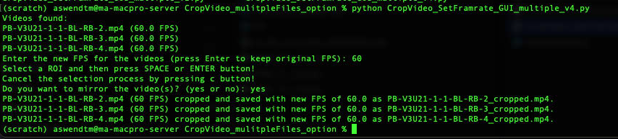
Solution 2
The Solution: for multiple videos
import os import tkinter as tk from tkinter import filedialog import cv2 def get_videos(): root = tk.Tk() root.withdraw() file_paths = filedialog.askopenfilenames(title='Choose video file(s)', filetypes=[('Video Files', '*.mp4')]) return file_paths def get_crop_box(video_path): cap = cv2.VideoCapture(video_path) _, frame = cap.read() cap.release() return cv2.selectROI(frame) def crop_video(video_path, crop_box, new_fps=None, mirror=False): cap = cv2.VideoCapture(video_path) fps = cap.get(cv2.CAP_PROP_FPS) if not new_fps: new_fps = fps width = int(cap.get(cv2.CAP_PROP_FRAME_WIDTH)) height = int(cap.get(cv2.CAP_PROP_FRAME_HEIGHT)) fourcc = cv2.VideoWriter_fourcc(*'mp4v') video_name, ext = os.path.splitext(video_path) video_name += '_cropped' save_path = video_name + ext out = cv2.VideoWriter(save_path, fourcc, new_fps, (int(crop_box[2]), int(crop_box[3]))) while True: ret, frame = cap.read() if not ret: break cropped_frame = frame[int(crop_box[1]):int(crop_box[1] + crop_box[3]), int(crop_box[0]):int(crop_box[0] + crop_box[2])] if mirror: cropped_frame = cv2.flip(cropped_frame, 1) out.write(cropped_frame) cap.release() out.release() return save_path, new_fps def process_multiple_videos(): video_paths = get_videos() if not video_paths: print('No videos selected.') return print('Videos found:') for video_path in video_paths: cap = cv2.VideoCapture(video_path) fps = cap.get(cv2.CAP_PROP_FPS) cap.release() print(f"{os.path.basename(video_path)} ({fps} FPS)") new_fps = input("Enter the new FPS for the videos (press Enter to keep original FPS): ") if new_fps: new_fps = float(new_fps) crop_box = get_crop_box(video_paths[0]) mirror_video = input("Do you want to mirror the video(s)? (yes or no): ") mirror = mirror_video.lower() == 'yes' for video_path in video_paths: save_path, fps = crop_video(video_path, crop_box, new_fps, mirror) if new_fps: old_fps_str = str(int(fps)) print(f"{os.path.basename(video_path)} ({old_fps_str} FPS) cropped and saved with new FPS of {new_fps} as {os.path.basename(save_path)}.") else: print(f"{os.path.basename(video_path)} ({int(fps)} FPS) cropped and saved as {os.path.basename(save_path)}.") process_multiple_videos()
CropVideo_SetFramrate_GUI_multiple_v4.py
Select multiple videos
Adjust FPS
First video opens => stop video with space, drag the mouse to select the blue crop area, space
Mirror yes/no?
Files will be saved

